Slide 1
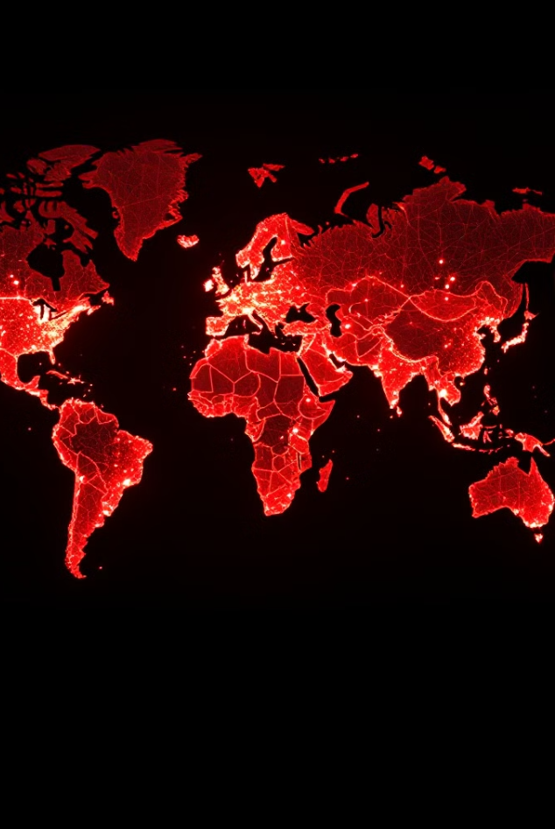

ASDS-6306- CAPSTONE PROJECT​
​
Sentimental Analysis of Social Media Tweets Using Machine Learning Technique
Naga Venkata Koteswararao Padarthi
​​ UTA ID: 1002200700​

Slide 2
Introduction
Results
Conclusion
Project Overview
Methodology
Ocean Analysis
Machine Learning Techniques
Outline

Slide 3
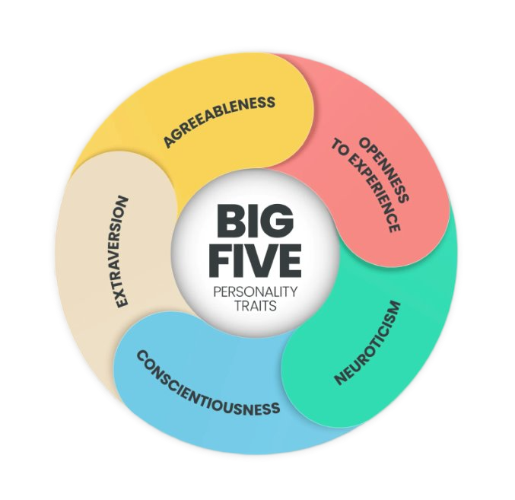
What is the Big Five Personality Model ?
It is a framework used to describe human personality and represents personality using five broad dimensions, often remembered as OCEAN​
Why personality prediction​ ?
Personality prediction helps understand human behavior and emotions by analyzing patterns in data, enabling accurate, automated insights into how individuals think and respond.

Slide 4
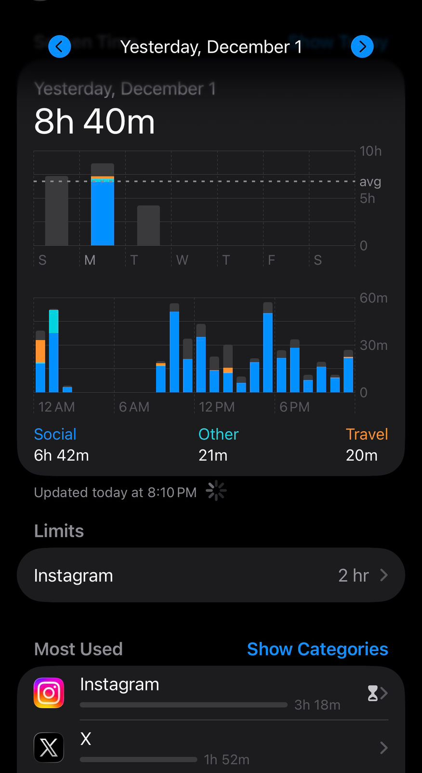
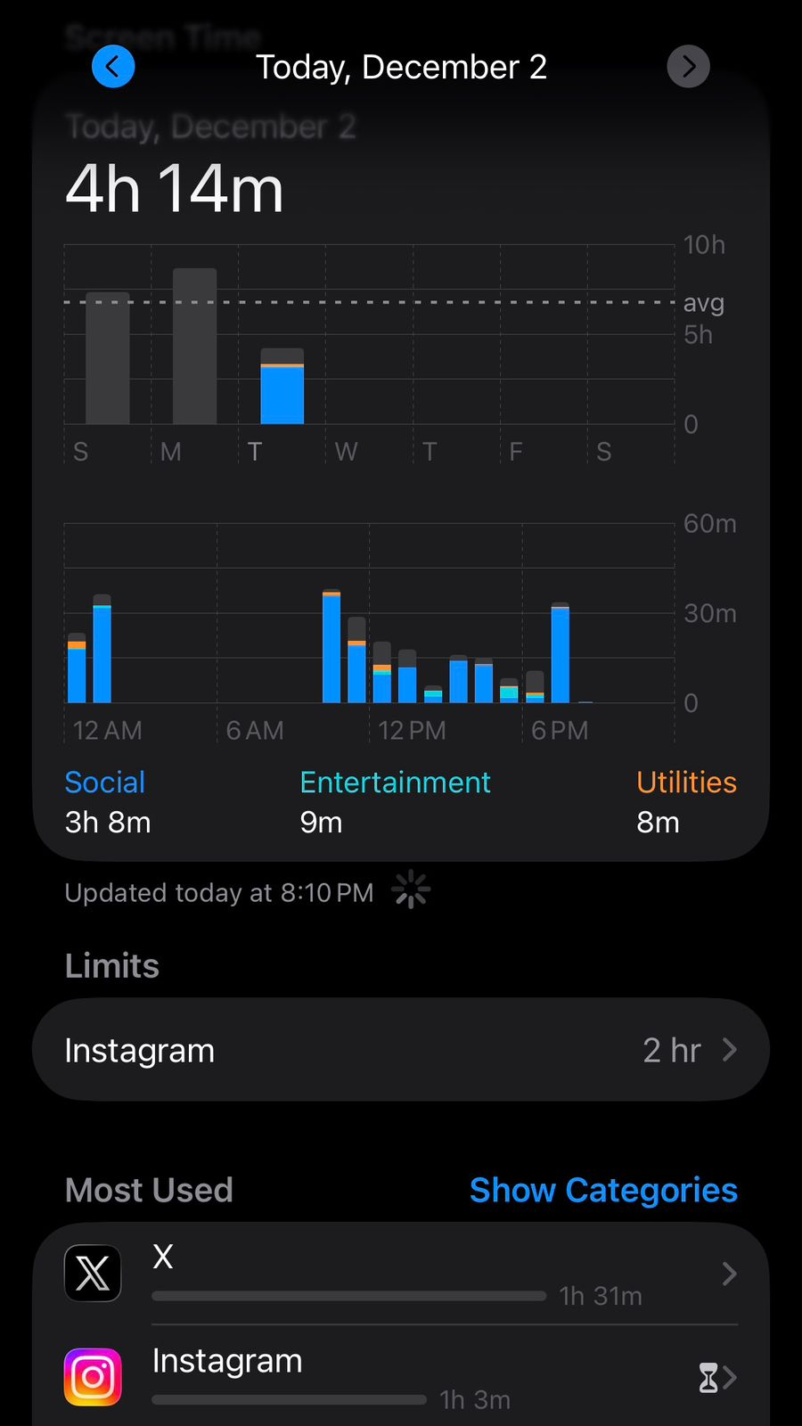
Taking myself as an example to show how people spend time on Social Media

Slide 5

Project Overview​
•A computationally difficult issue has emerged as a result of the explosive growth in Internet users which is predicting a user's personality from their digital footprints.
•The main goal of this project is to detect the personality of people around the world by collecting the data from their statements in the Twitter Tweets.
•Trying different machine learning algorithms and feature selection algorithms to find out the best suitable combinations of algorithms to predict personality.

Slide 6

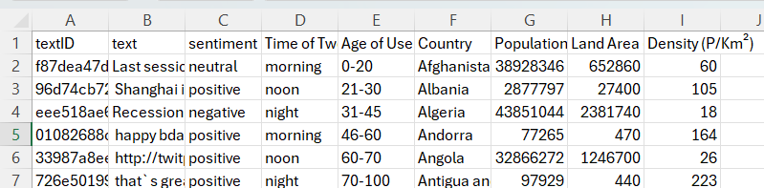
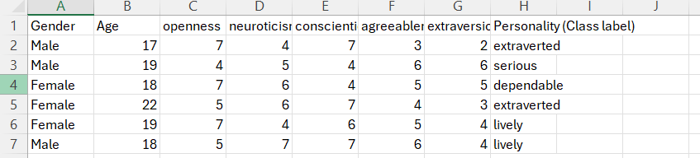
Data Overview
For this project purpose I used two datasets.
One contains the tweets, user id, location, age and few others features.
Another one contains BIG 5 Personality scores (OCEAN ), personality Lables.

Slide 7
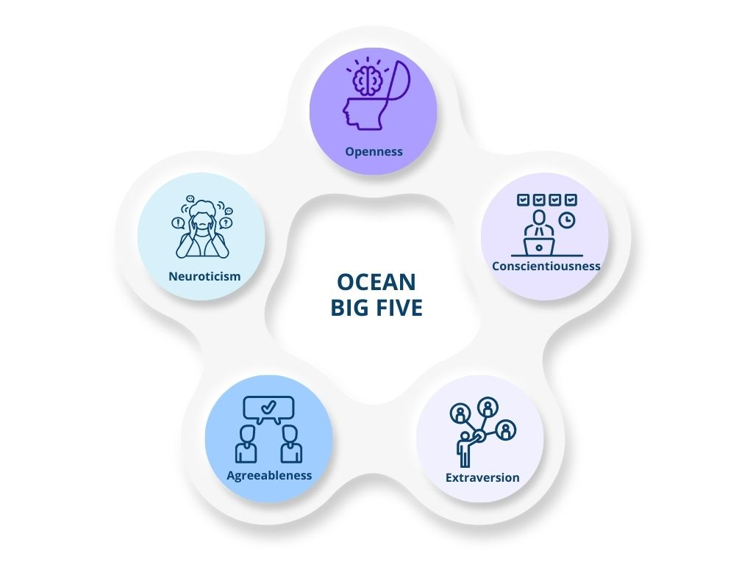
​
OCEAN Analysis:
​
Openness
Creativity, imagination, curiosity​
Willingness to try new ideas and experiences​
​
Conscientiousness​
Organization, responsibility, self-discipline​
Dependable and goal-oriented behavior​
​
Agreeableness​
Friendly, empathetic, and cooperative​
Tendency to maintain positive relationships​
​
Extraversion​
Sociability and outgoing nature​
High energy, assertiveness, and enthusiasm​
​
​
Neuroticism​
Emotional instability and stress sensitivity​
Prone to anxiety, mood swings, and negative emotions​
​

Slide 8
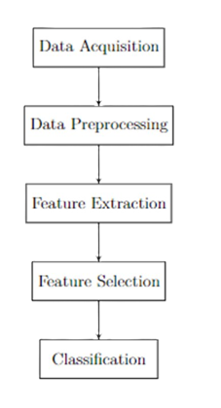

Methodology

Slide 9
Data Acquisition:
The dataset used in this project was obtained from social-media sentiment analysis datasets published on Kaggle. These datasets contain user-generated text tweets along with associated metadata. For personality prediction, these text samples were later enriched with OCEAN personality scores.
Data Pre-processing :
All the statements in the data set are completely in English and the data should be preprocessed.
The preprocessing step includes removing the punctuation marks, converting words to tokens, removing stop words, converting words into root forms and stemming.
All of these preprocessing operations are done using NLTK library.

Slide 10
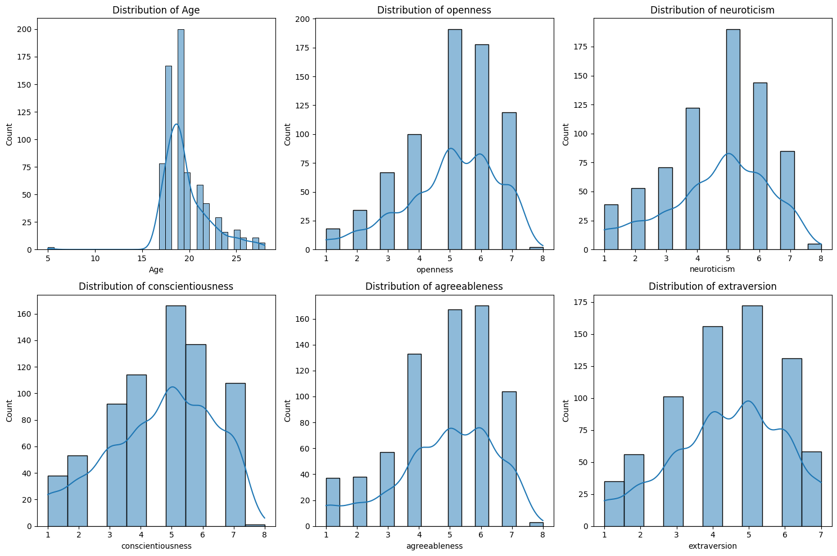
Distribution plots (Age, Openness, Neuroticism, Extraversion, Agreeableness, Conscientiousness)

Slide 11
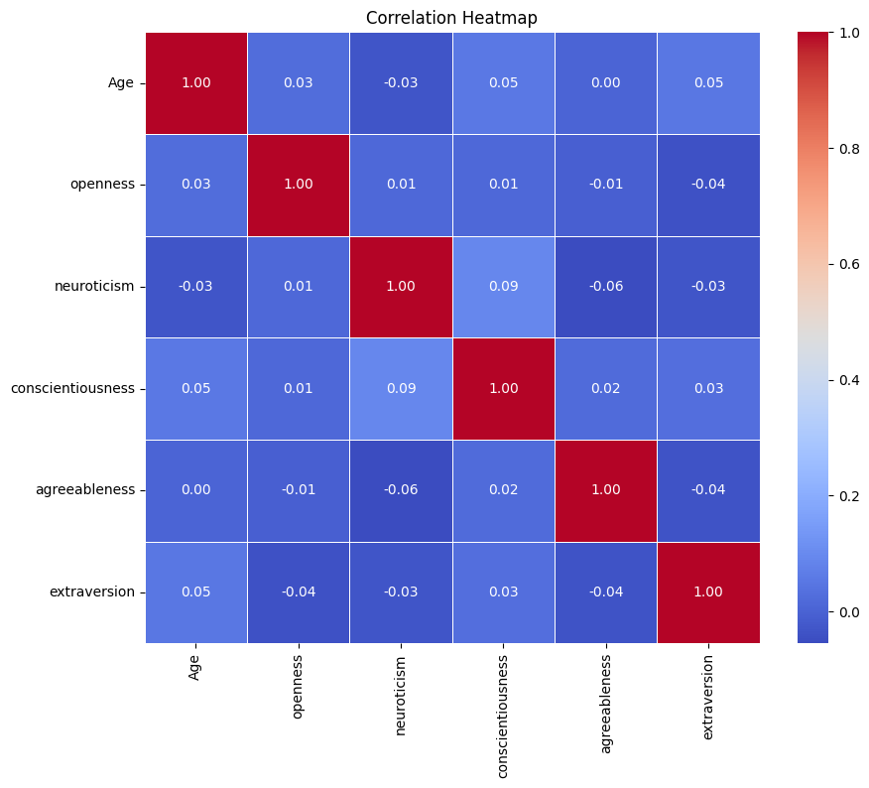

Slide 12
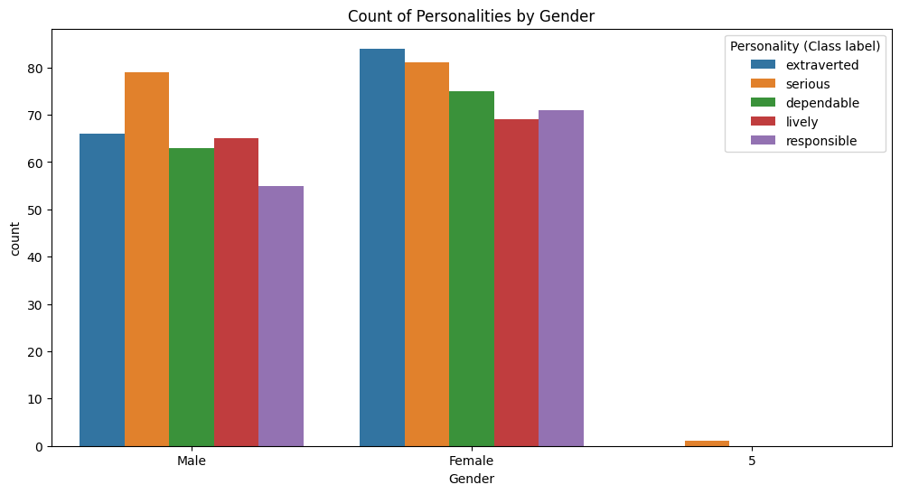

Slide 13

Feature Selection ​
PCC - Pearson Correlation Coefficient
Chi- Squared test
Information Gain
Machine Learning Techniques​
Decision Tree
Random Forest
Naive Bayes

Slide 14
Results
Features Selection | Decision Tree | Random Forest | Naive Bayes
PCC | 79.95% | 79.38% | 80.77%
Chi- Squared test | 89.96% | 89.87% | 73.15%
Information Gain | 78.97% | 79.40% | 82.53%

Slide 15
Feature selection algorithms

Slide 16

Conclusion
The Comparative analysis of Machine Learning algorithms for predicting personality traits using text data from people's tweets yielded promising results.
Among the three techniques tested, the Machine learning techniques Decision Tree, Random Forest with the combination of Chi-squared test demonstrated superior performance, achieving an accuracy of 89.96% & 89.87% for predicting the personality label .

Slide 17
